Slide 1

DIGITAL MARKETING
^{Field Visiting Business}
^{For Interviewing}
^{About Digital Marketing}
By
G.Jeevitha
V.Harithasri
O.Kavitha
P.K.Gayathri

Slide 2

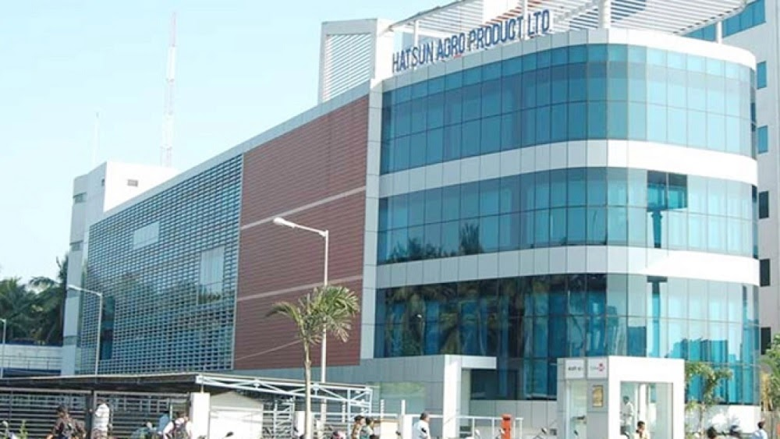

Slide 3
Hatsun Agro Product Ltd (HAP), often referred as Hatsun (HAP), is a leading private sector dairy company in India with headquarters in Tamil Nadu, Chennai. It was founded by R. G. Chandramogan in 1970. "World wants India to become a cooperated ltd" was his motto.The company was also awarded "The Fastest Growing Asian Dairy Company". The dairy product maker has been bagging the Golden Trophy from the Indian Government for the largest dairy products exporter for the last many years.

Slide 4
Hatsun Agro Product Ltd : Type :Public company Traded as BSE : 531531 NSE : HATSUN ISIN INE473B01035 Founded in 1970; 53 years ago Founder : R.G. Chandramogan Headquarters : Chennai, Tamil Nadu, India Area served : India Key people : R. G. Chandramogan (Chairman) C. Sathyan (Managing Director)

Slide 5
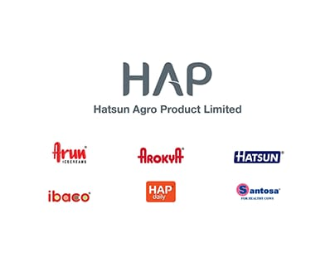
Products Dairy products Brands: Arun Icecreams , Arokya ,HatsunHAP ,dailyIbaco ,Santosa Revenue : Increase₹5,400 crore (US$680 million) (2018) Operating income : Increase₹746.36 crore (US$93 million) (2018) Net income : Increase₹382.63 crore (US$48 million) (2018) Website : www.hap.in

Slide 6
The company has tripled its total turnover over the past 3 years and is set to become the fastest-growing dairy company in the world, with a record growth rate of 116% over the past 3 successive Quarters. During the financial year 2011–2012, the company grew at a rate of 23.6%.

Slide 7
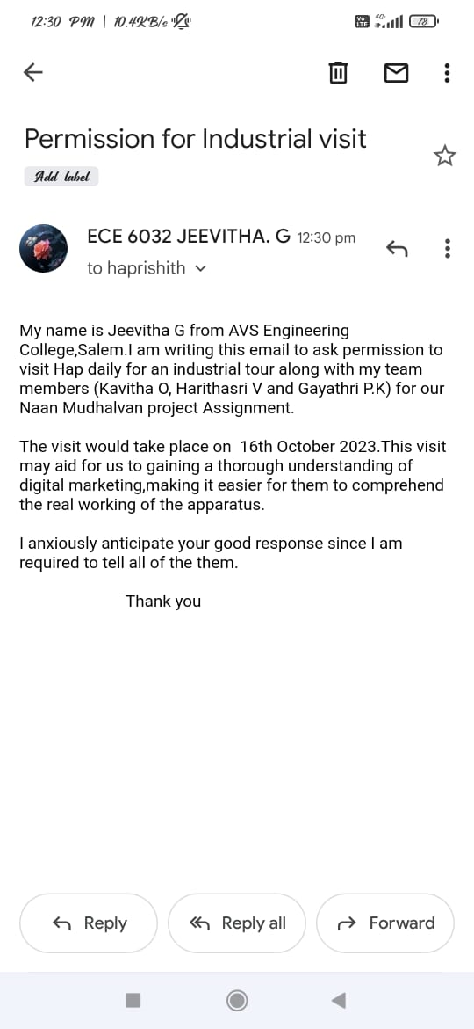

Slide 8
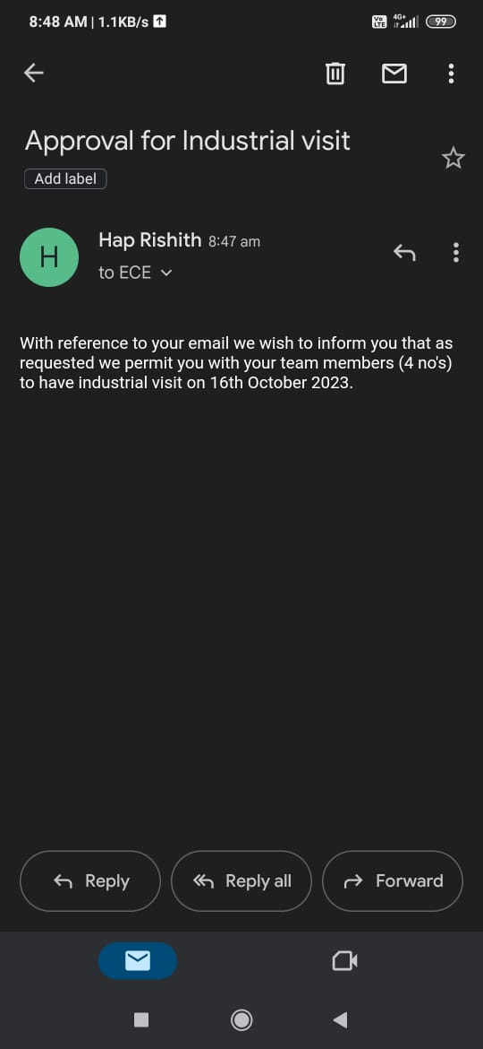

Slide 9
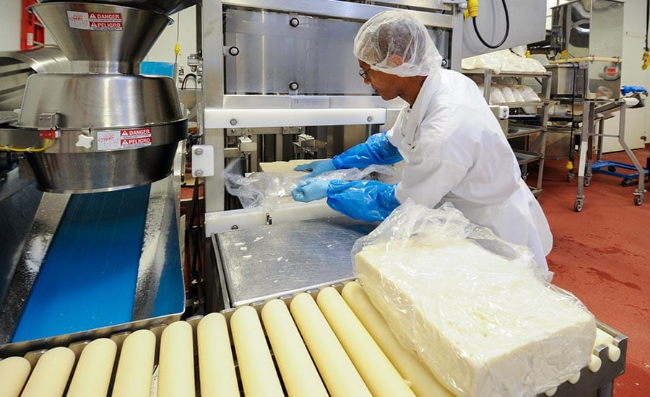
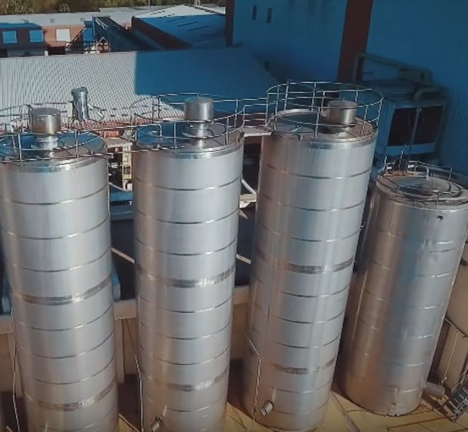

Slide 10

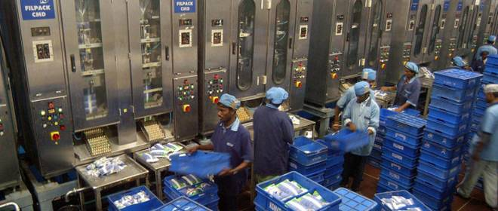

Slide 11
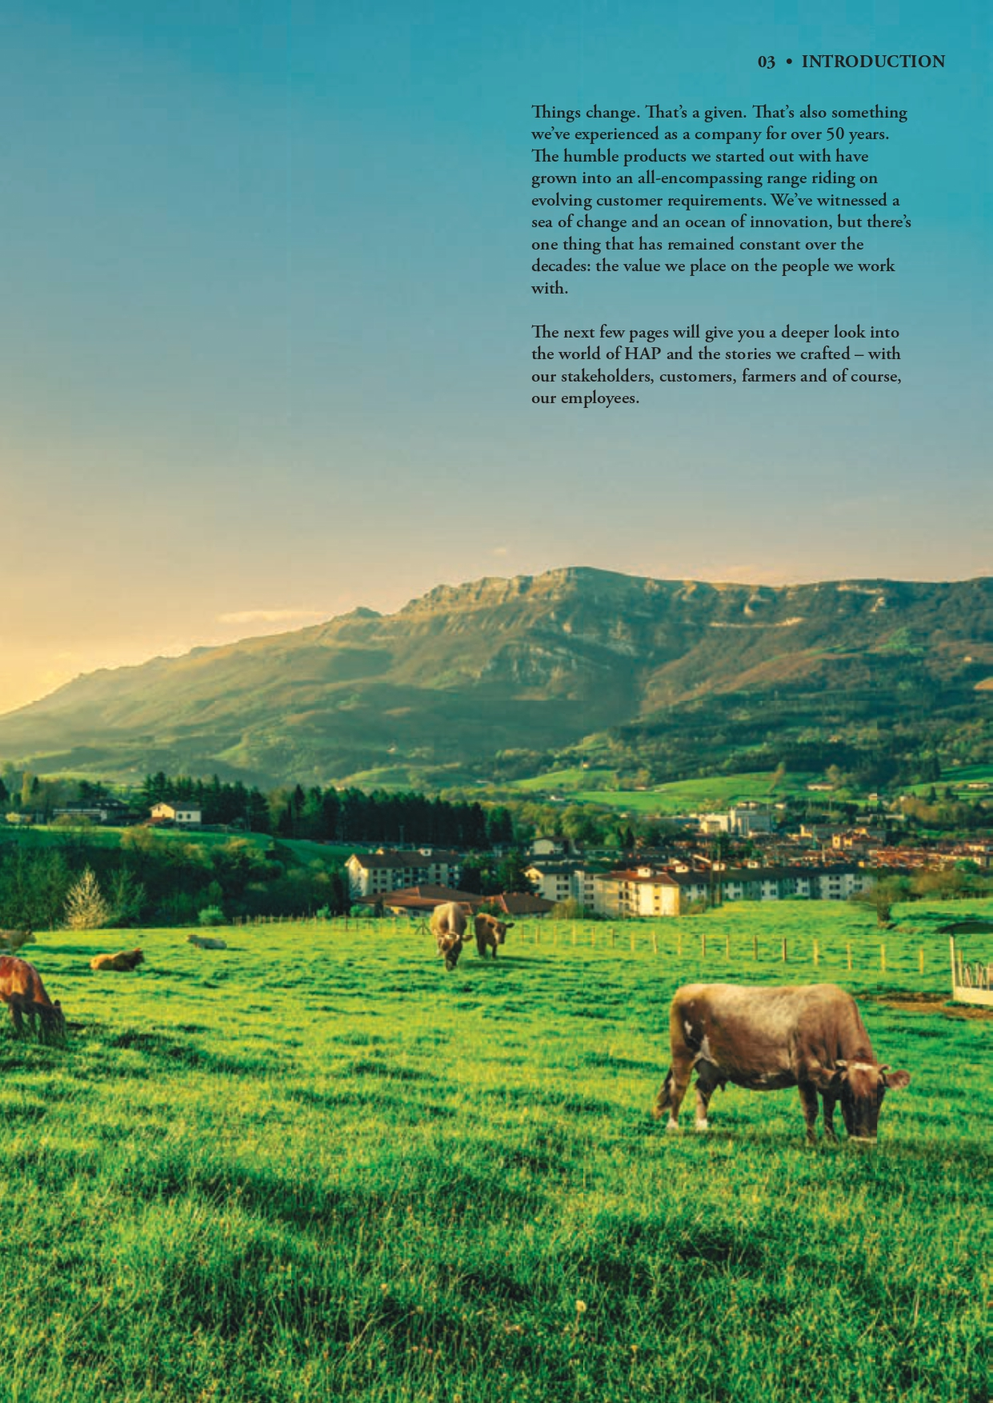

Slide 12
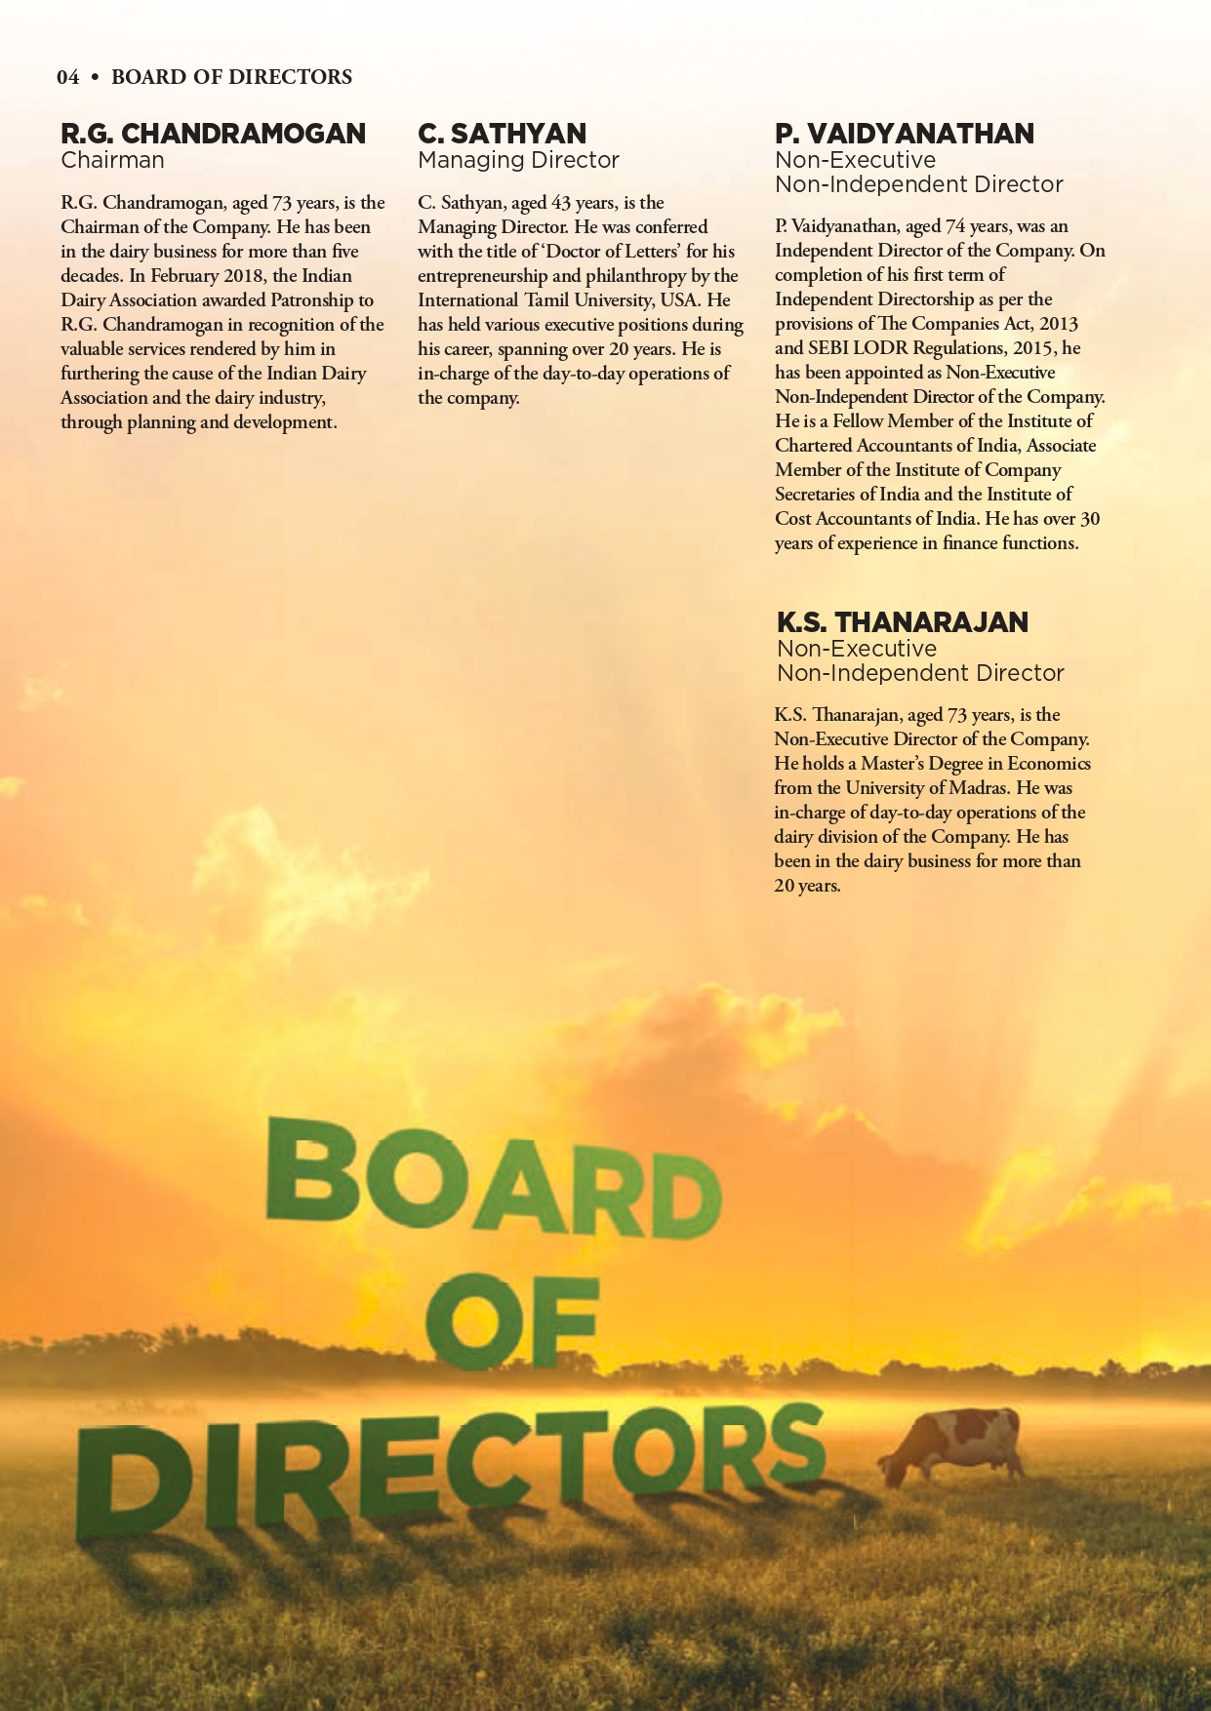

Slide 13
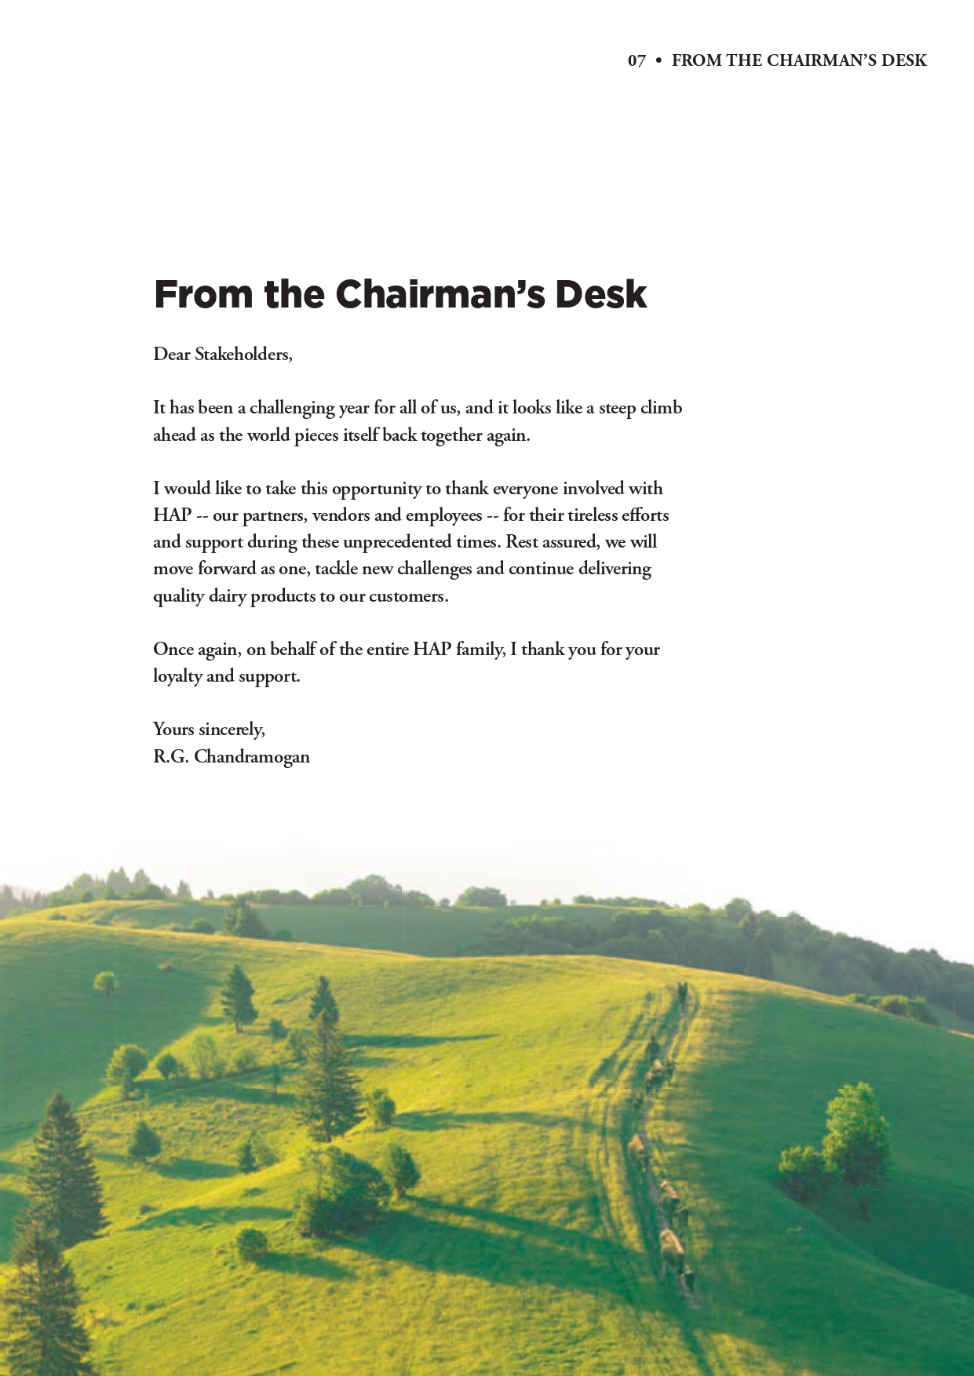

Slide 14
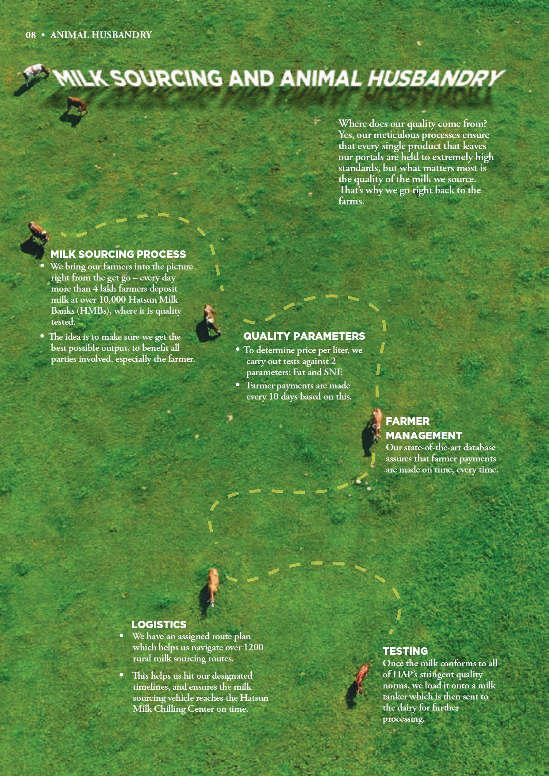

Slide 15
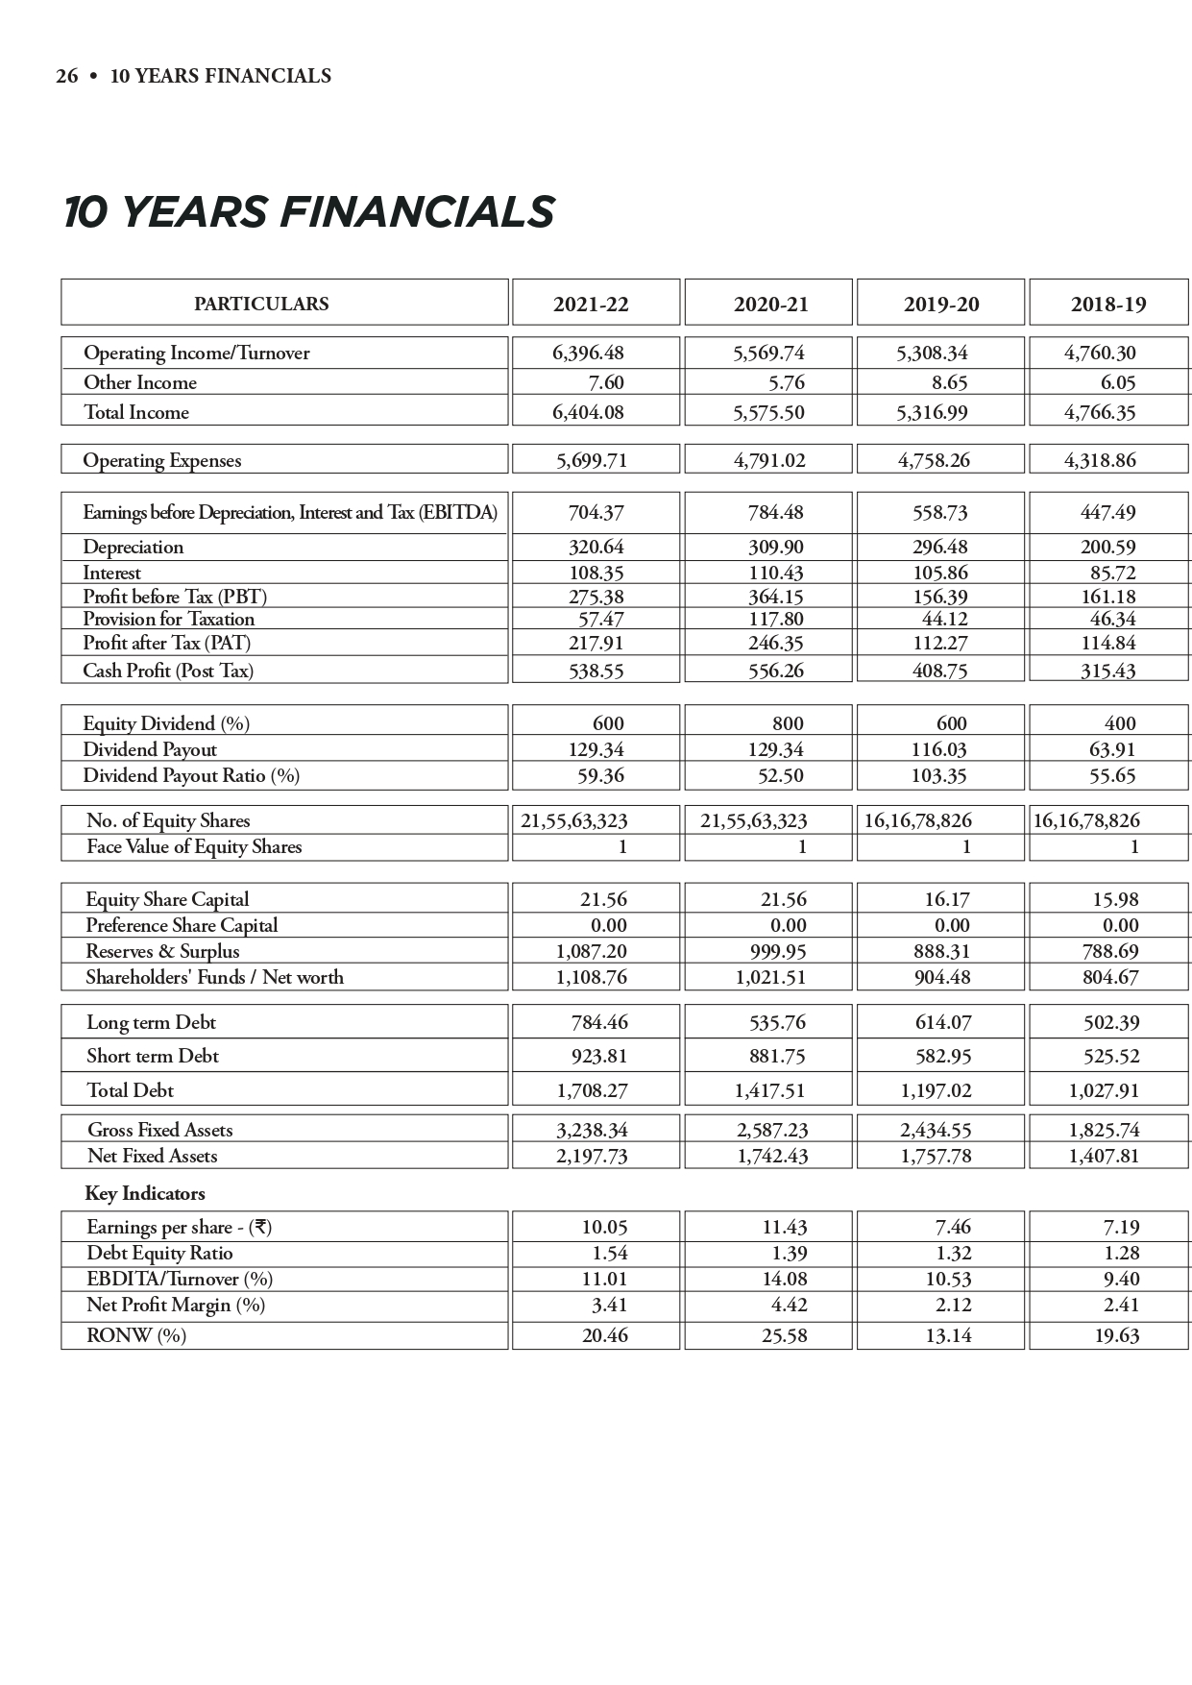

Slide 16
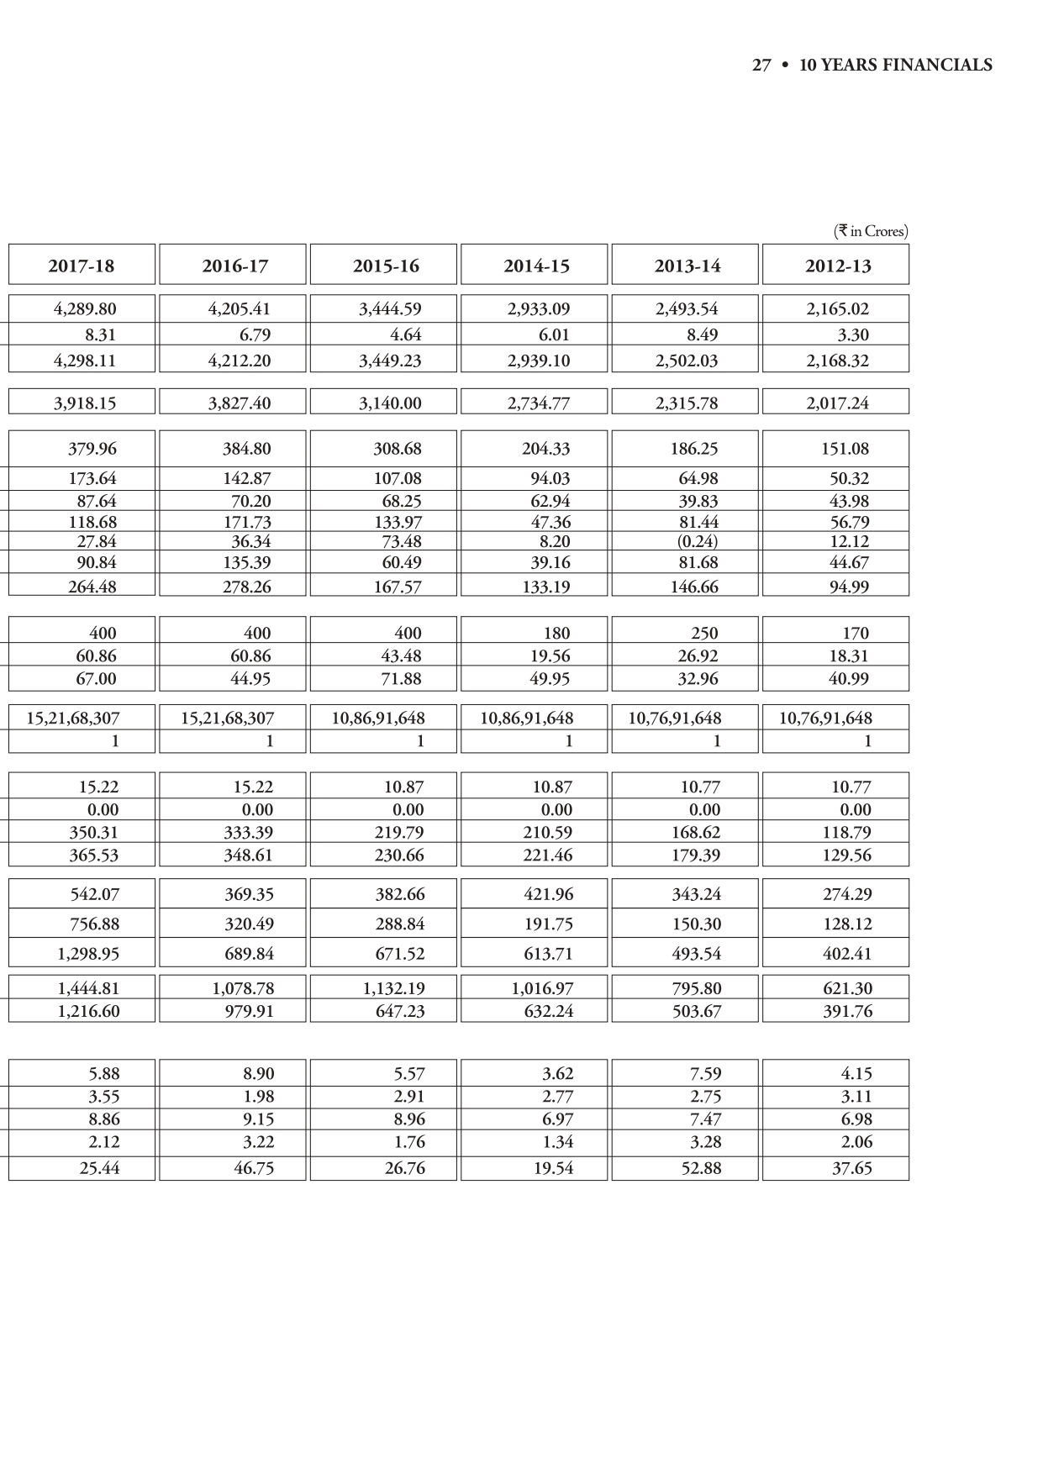

Slide 17
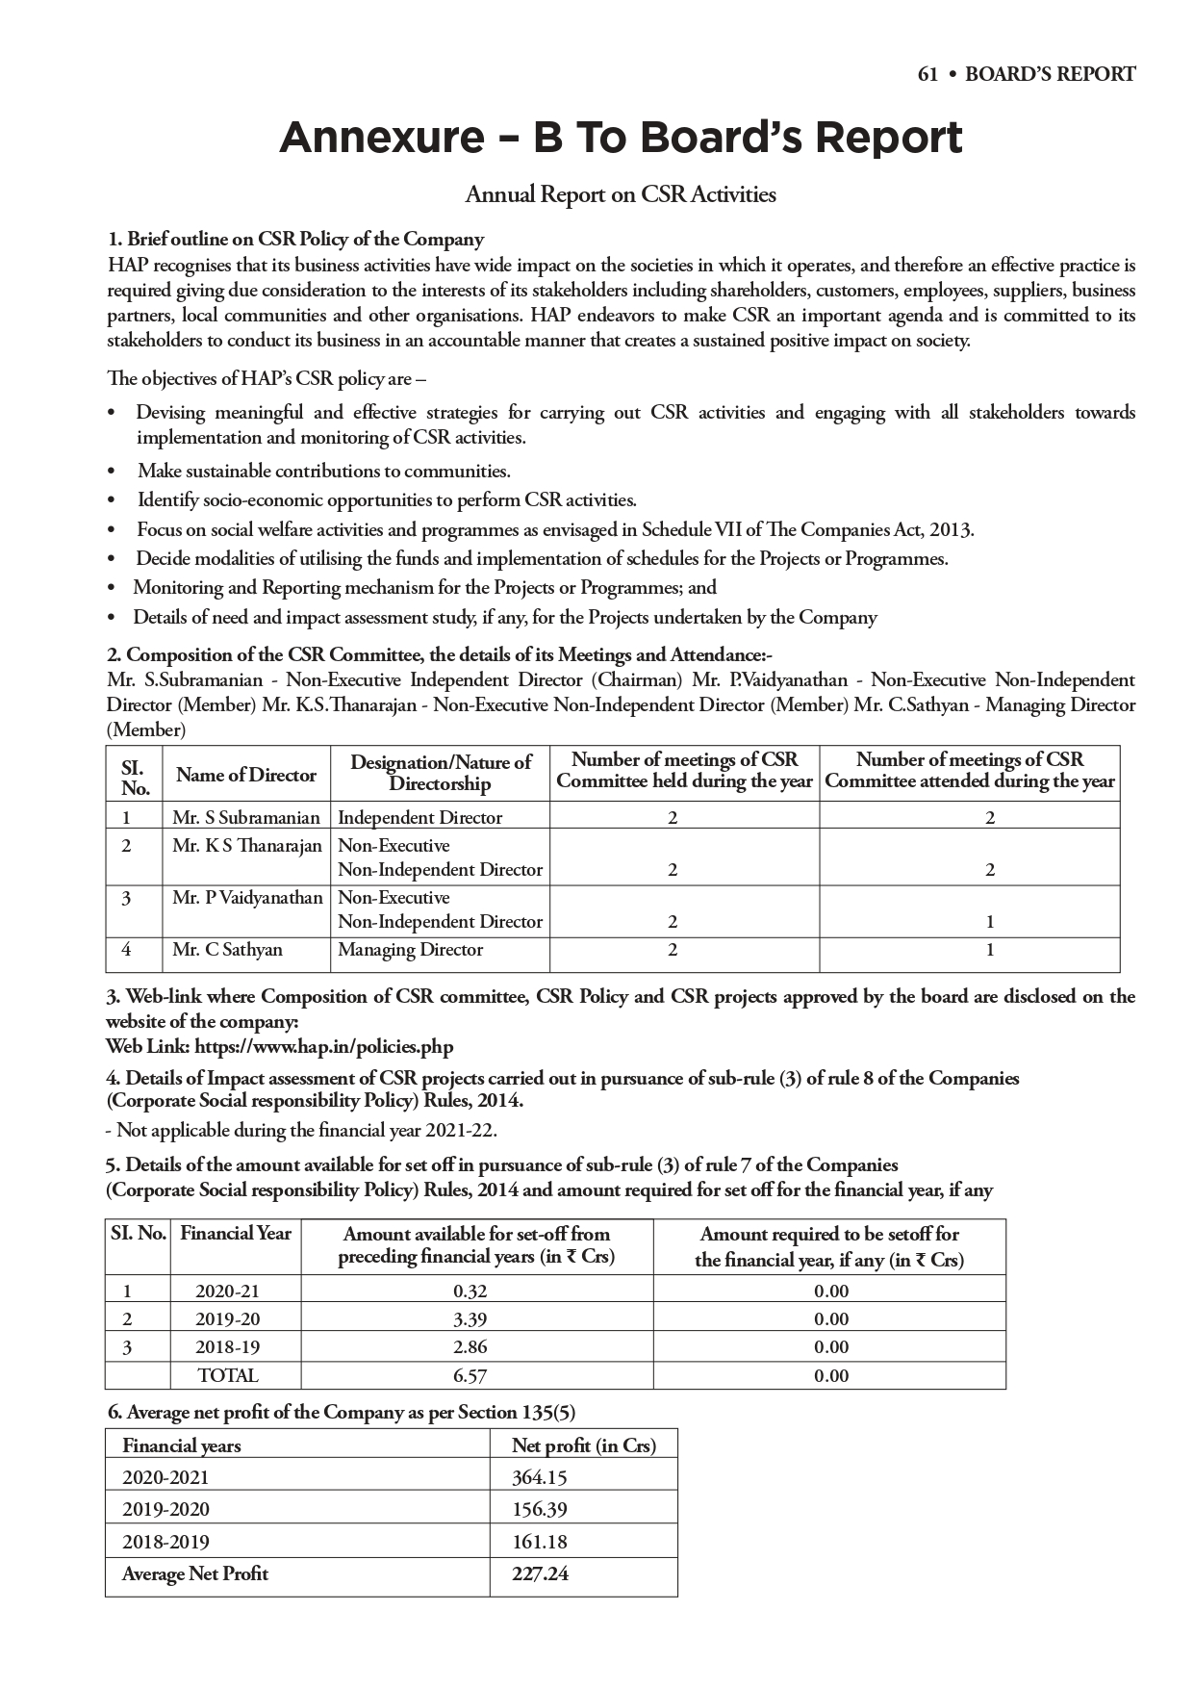

Slide 18
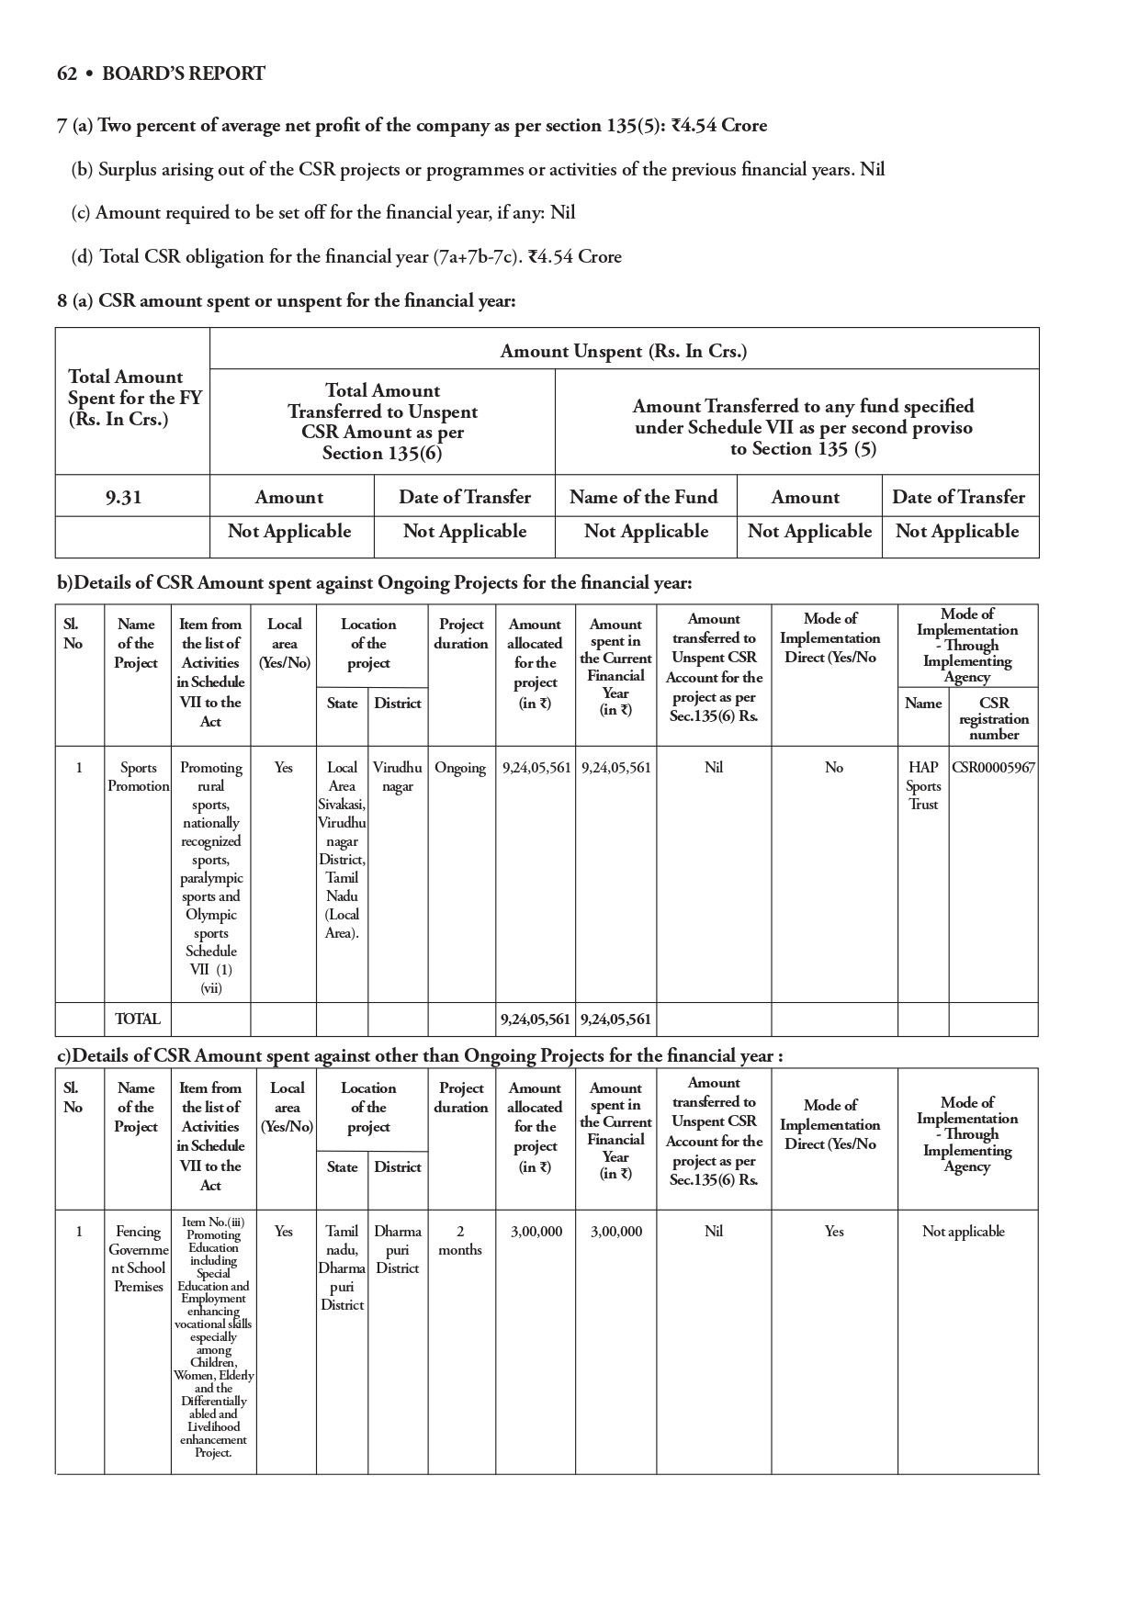

Slide 19
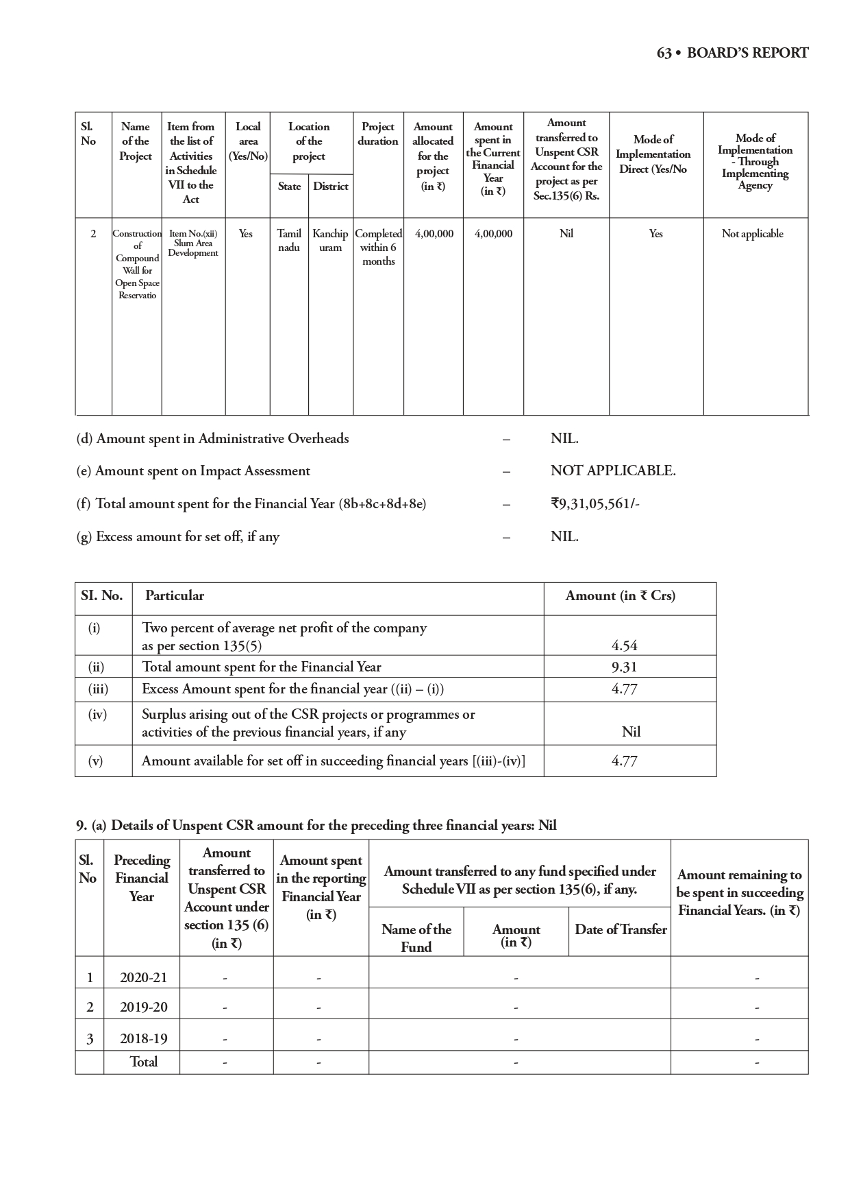

Slide 20
https://drive.google.com/file/d/1KtrThaaXecwghH-RY7SMqRh4YaffQYDc/view?usp=drivesdk

Slide 21
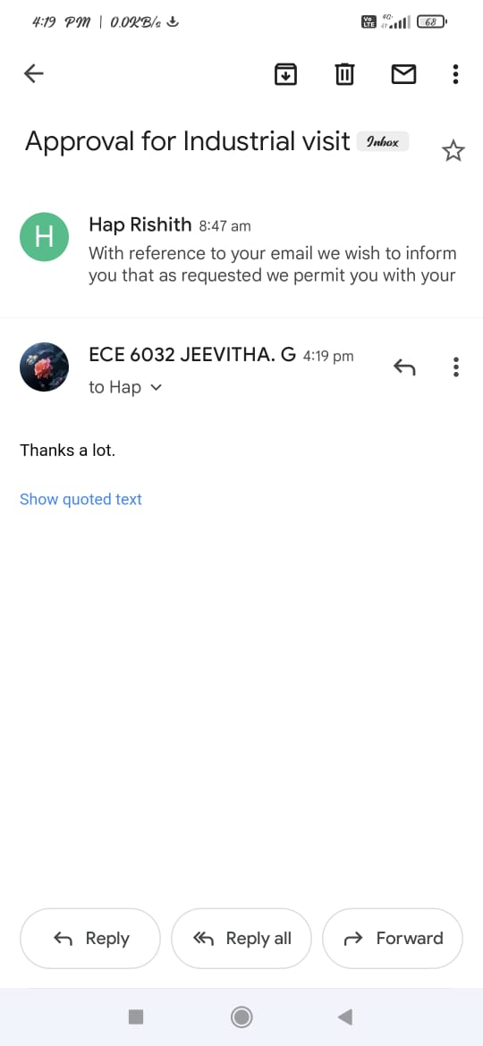

Slide 22


